Slide 1

Development of a Data-Related Job Salary Calculator Based on Data Science Salary Trends for US Workers – 1Q2023
Rutgers Data Visualization Bootcamp – Group 3
June 2023
June 11, 2023
Data-Related Jobs Salary Predictor app

Slide 2



Agenda
Introduction
Data Cleaning
Building the Model
Website Development
Data Modeling Implementation
Lessons Learned
June 11, 2023
Data-Related Jobs Salary Predictor app
2

Slide 3




Introduction
The aim of this project was to create a model and app to predict salary of data science jobs in the US based on job title.
Data source: Self-reported data from employees to aijobs in 1Q2023. Original csv from Kaggle 31May2023.
The project team successfully created a random forest model that predicts salary and an app for a user to interact with the model.
June 11, 2023
Data-Related Jobs Salary Predictor app
3

Slide 4

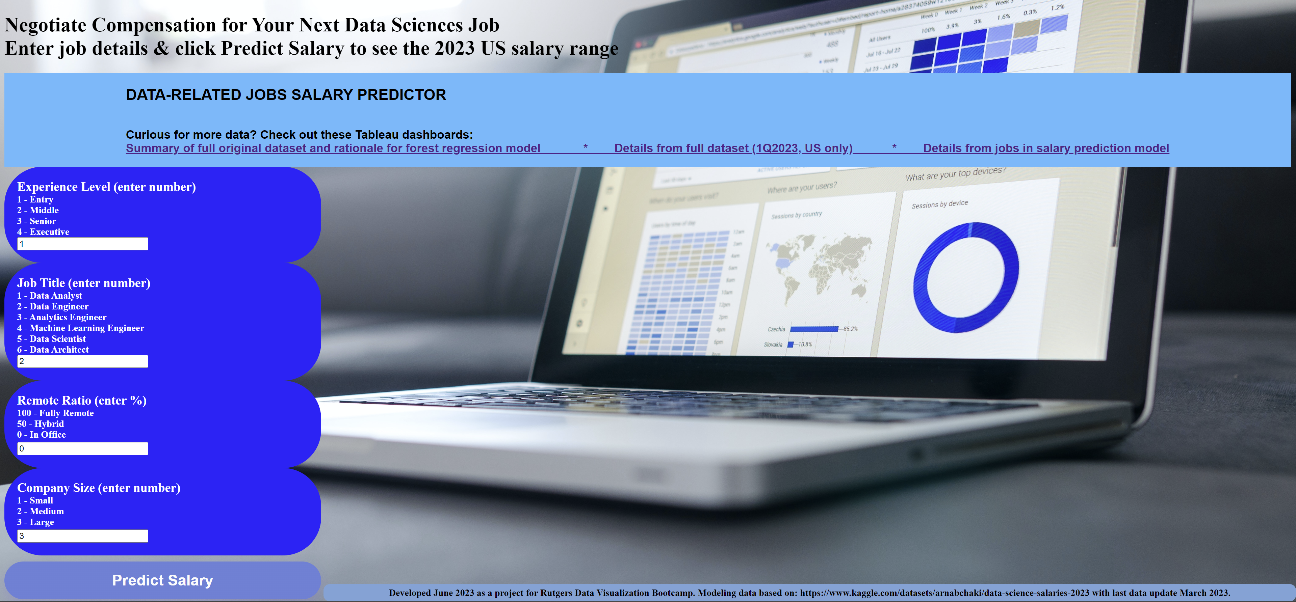
June 11, 2023
Data-Related Jobs Salary Predictor app
4

Slide 5










Tools Used
 | Python | Pandas | Micro-soft csv | Path | Tableau | Scikit-learn | Flask | pickle | HTML | CSS | Power-point | GitHub
Cleaning |  | X | X | X | X
Analysis |  | X | X | X | X |  |  |  |  |  | X
Visualization |  |  | X |  | X |  |  |  | X | X
Modeling |  | X | X | X |  | X
Website development | X |  |  |  |  |  | X | X | X | X
Reporting |  |  |  |  |  |  |  |  |  |  | X | X
June 11, 2023
Data-Related Jobs Salary Predictor app
5

Slide 6





Team
Sana Ayubzai
Minta Burke
Tawn Scotton
Aaron Lilleoien
Calogera McCormick
Data Scientist
Data Engineer
Data Architect
Data Analyst
Technical Project Manager
Select Dataset
Data Cleaning
Data Analysis & Building the Model
Website Development
Implementing the Model
June 11, 2023
Data-Related Jobs Salary Predictor app
6

Slide 7
Dataset Overview – Original csv
Original column | Description | Filter | Modification | In Refined csv | In final model
work_year: | year the salary was paid
employment_type: | type of employment for the role
employee_residence | employee's primary country of residence in during the work year as an ISO 3166 country code
salary: | total gross salary amount paid
salary_currency: | currency of the salary paid as an ISO 4217 currency code
company_location: | country of the employer's main office or contracting branch
experience_level: | experience level in the job during the year
job_title: | role worked in during the year
salaryinusd: | salary in USD
remote_ratio: | overall amount of work done remotely
company_size: | median number of people that worked for the company during the year

Slide 8

Data Cleaning
Used Tableau to visualize full dataset. Identified roles with highest frequency and features (eg, ex-US countries, contractor job type) with low frequency.
Dropped null values and null values.
Identified columns that did not add value & marked for deletion.
Used Python to refine dataset.
Grouped data - combined all job titles into 7 grouped titles (ie, Data Analyst, Data Architect, Data Engineer, Data Manager, Data Scientist, Developer, Other)
Binned data – 8 bins of salary data from <50K to >400K USD
Codified features that were categorical data (eg, experience level updated to 1, 2, 3, 4).
June 11, 2023
Data-Related Jobs Salary Predictor app
8

Slide 9
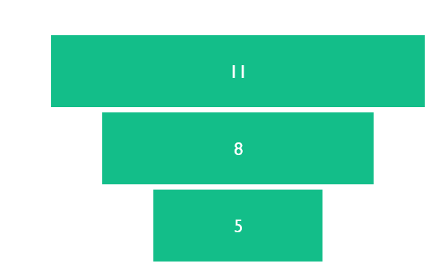
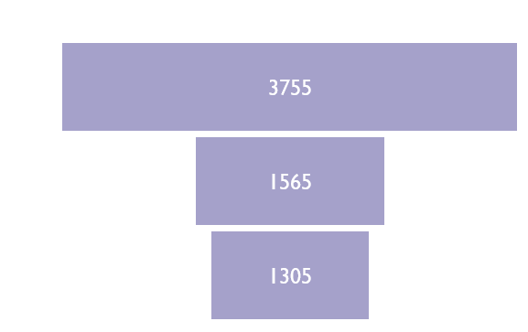
Summary of Data Volume per Step

Slide 10
Dataset Overview
Original column | Description | Filter | Modification | In Refined csv | In final model
work_year: | year the salary was paid | 2023 | none
employment_type: | type of employment for the role | Full-time | Coded 1 to 2, then dropped contractors | X
employee_residence | employee's primary country of residence in during the work year as an ISO 3166 country code | US | none
salary: | total gross salary amount paid | Dropped
salary_currency: | currency of the salary paid as an ISO 4217 currency code | Dropped
company_location: | country of the employer's main office or contracting branch | Dropped
experience_level: | experience level in the job during the year | All included | Coded 1 to 4 | X | X
job_title: | role worked in during the year | All included | Grouped and coded 1 to 8; dropped some; regrouped and recoded 1 to 6 | X | X
salaryinusd: | salary in USD | Included | Binned and coded 1 to 8, then 1-4 | X | X
remote_ratio: | overall amount of work done remotely | Included | none | X | X
company_size: | median number of people that worked for the company during the year | Included | Coded, 1 to 3 | X | X

Slide 11
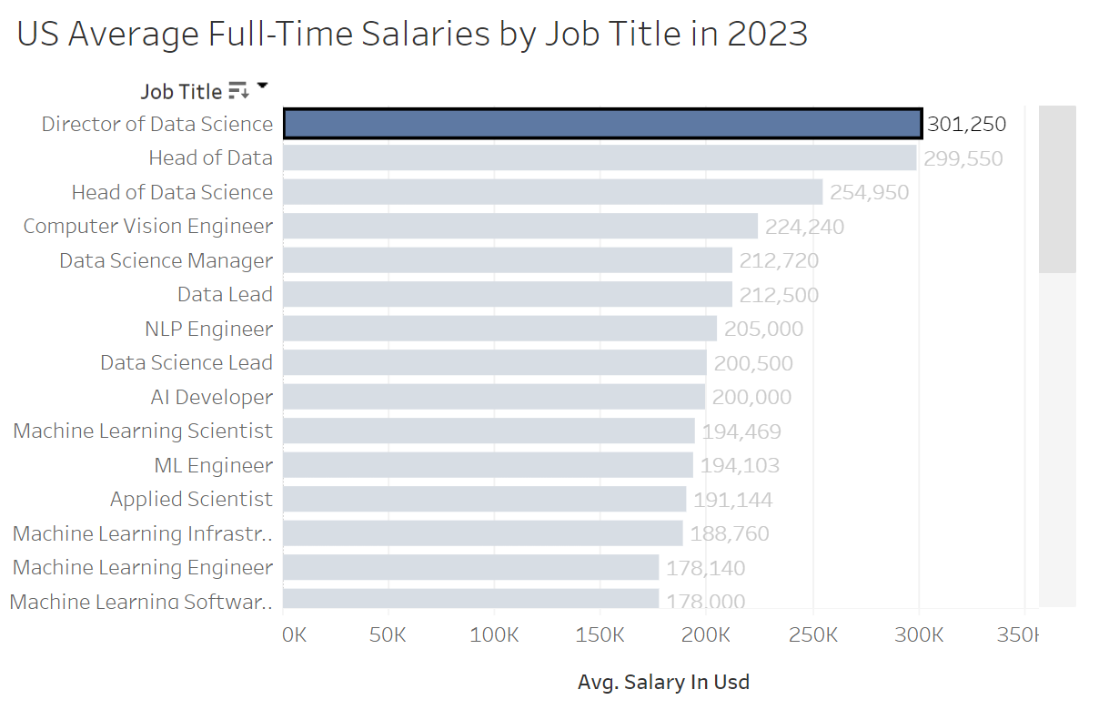
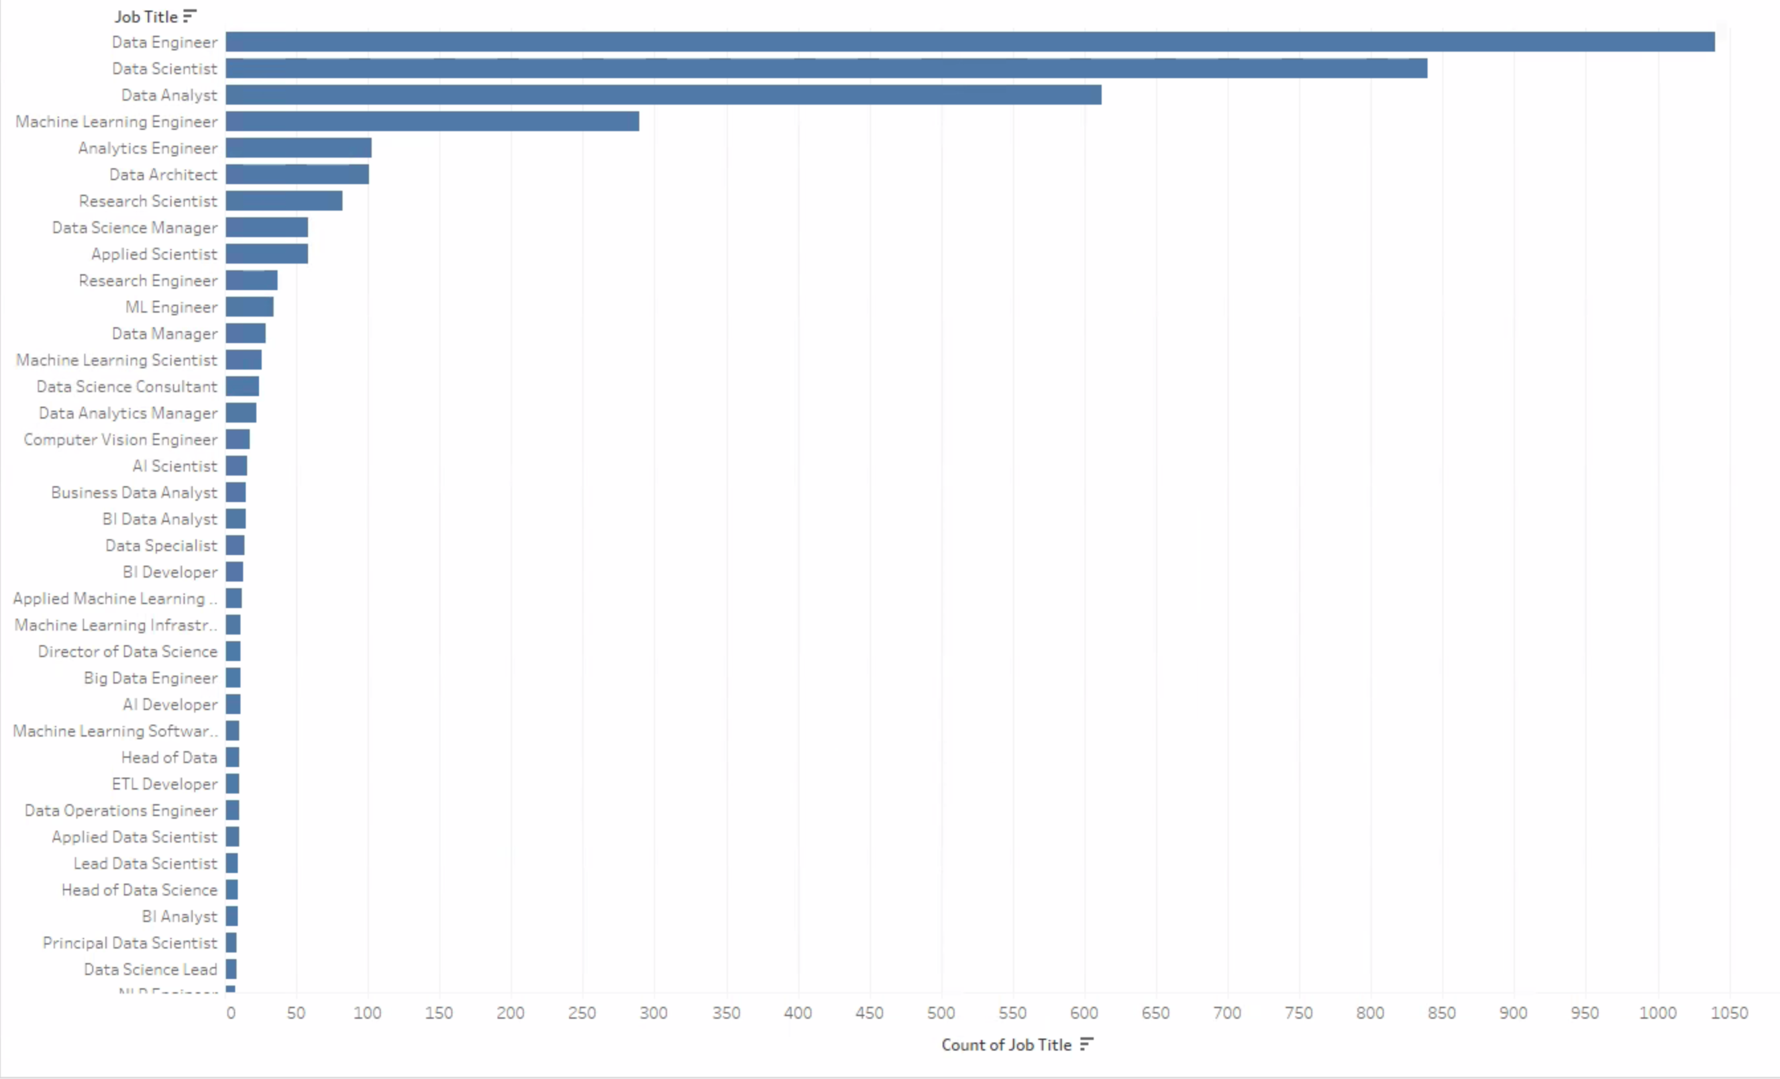
Data Cleaning – Refining the Dataset (1)
Average Salary by job title
COUNt of ENTRIES PER JOB TITLS IN ORIGINAL DATASET
June 11, 2023
Data-Related Jobs Salary Predictor app
11

Slide 12
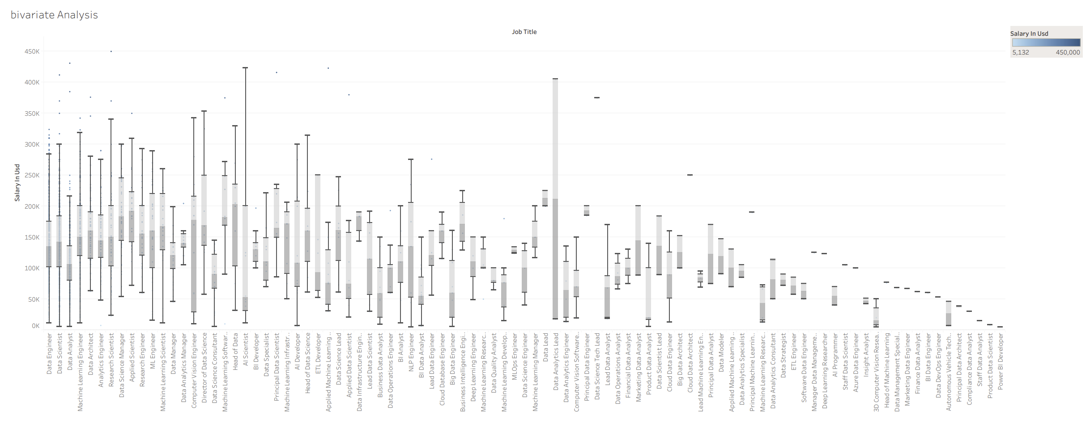
Data Cleaning – Refining the Dataset (2)
Bivariate Analysis
June 11, 2023
Data-Related Jobs Salary Predictor app
12

Slide 13
Building the Model
Gathered and prepared the data: Imported the refined csv from the data cleaning.
Split the data into training and test data sets.
Identified the features (job category, experience level, remote ratio, company size) and target variable (ie, salary in USD).
Trained and tested a forest regression model.
Evaluated model and finetuned the model.
Checked that model returned logical predictions based on a variety of input combinations
June 11, 2023
Data-Related Jobs Salary Predictor app
13

Slide 14
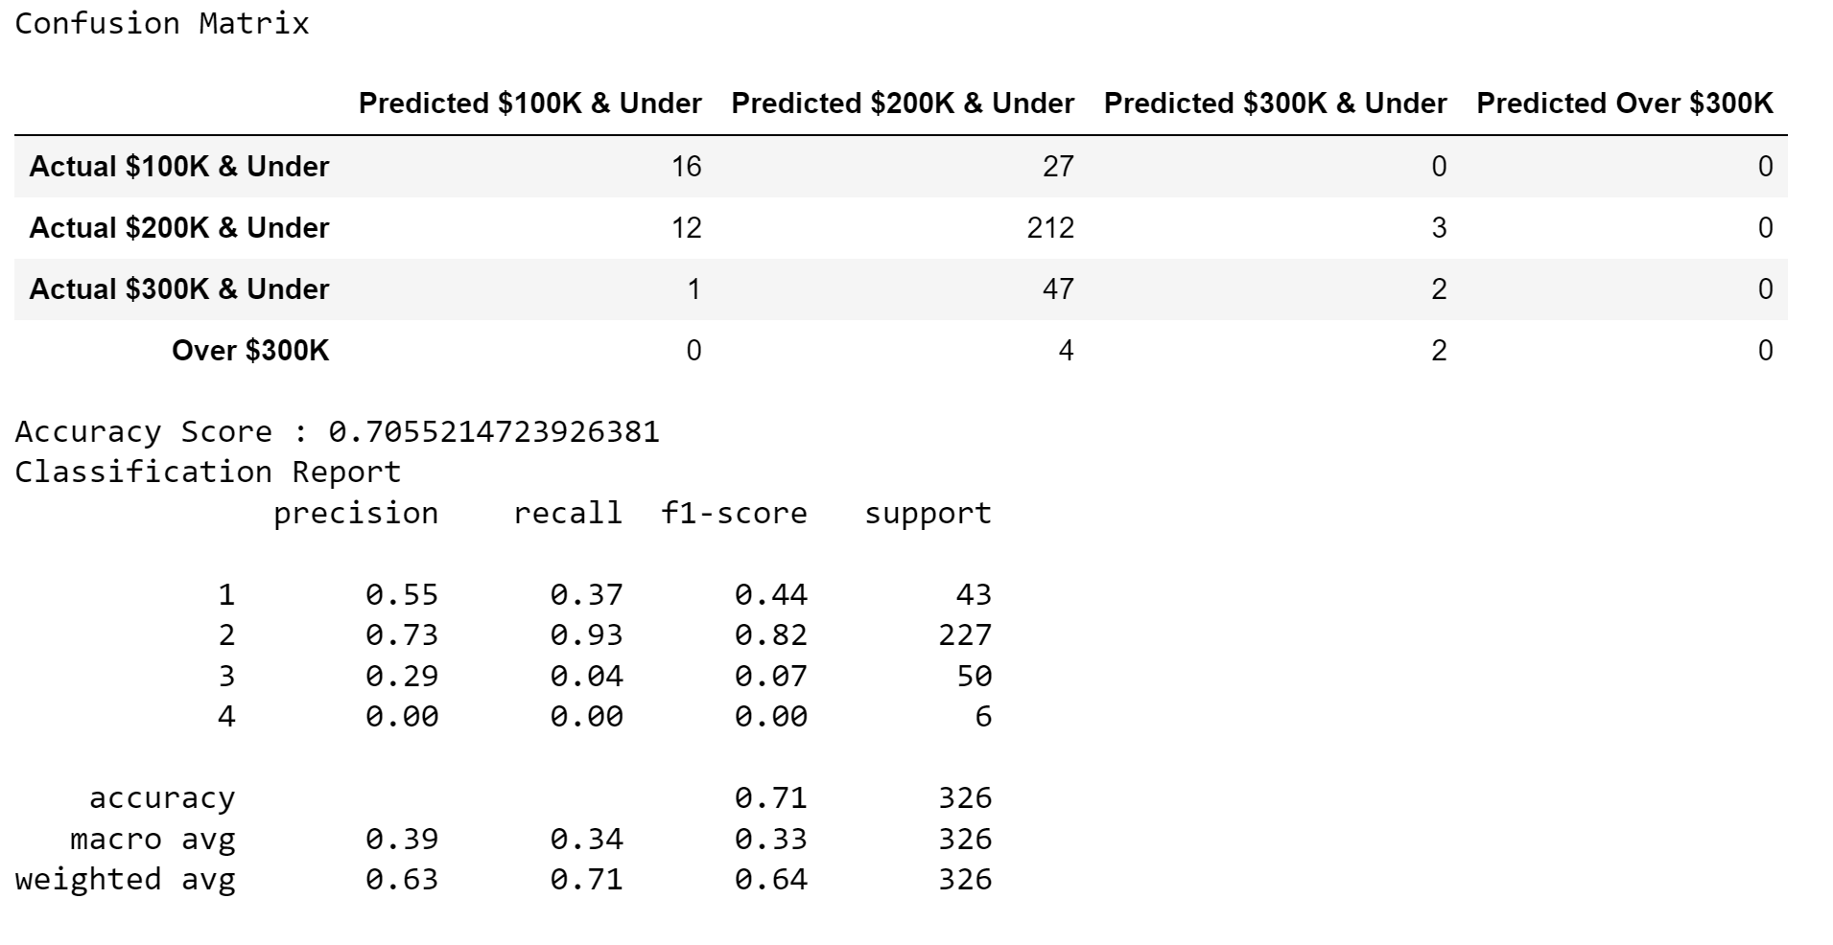
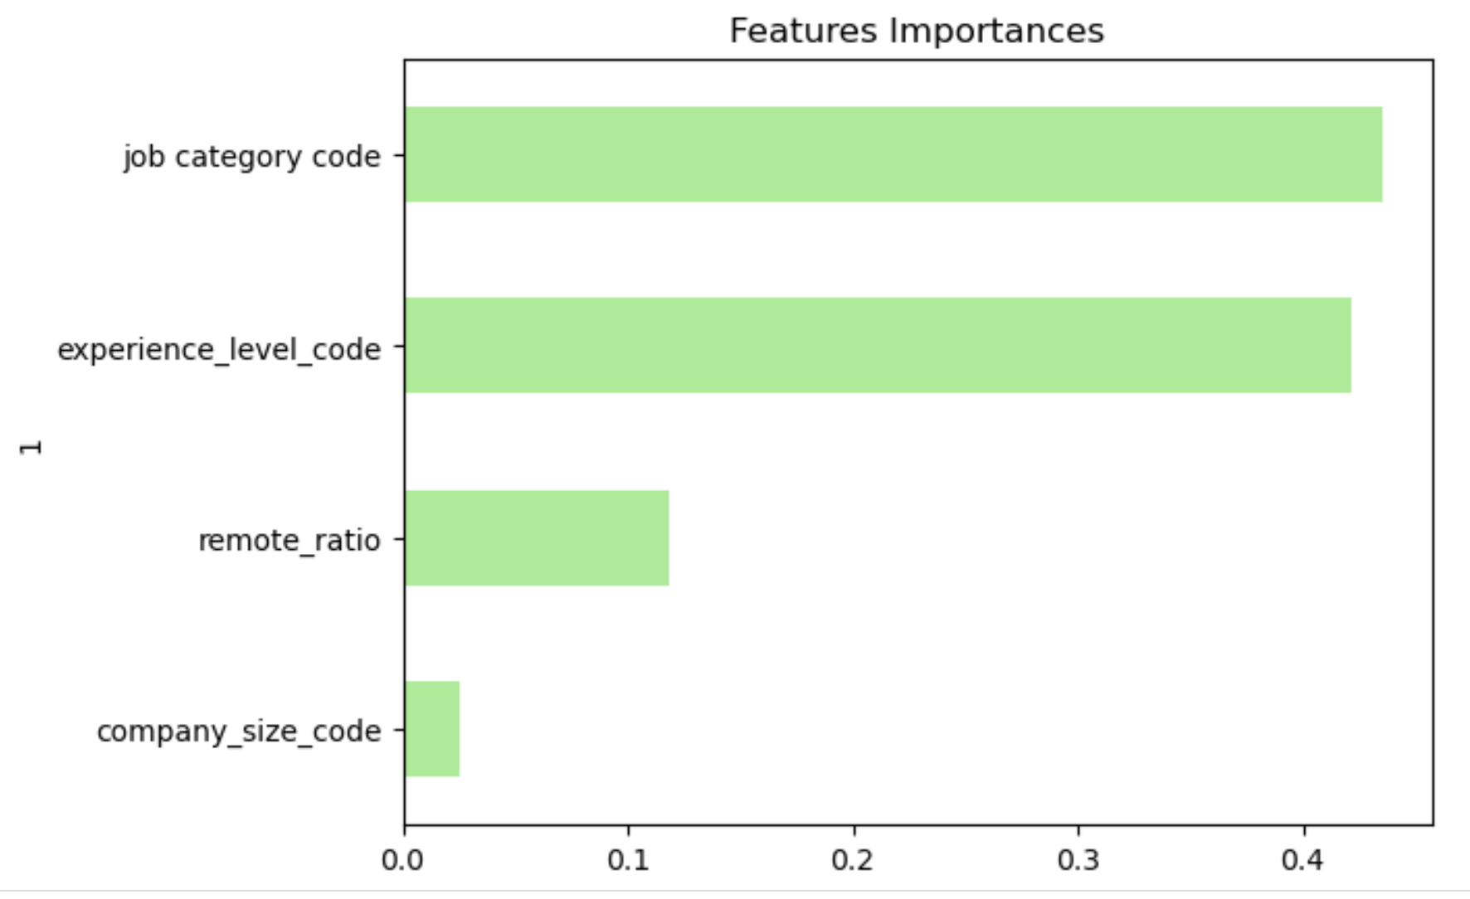
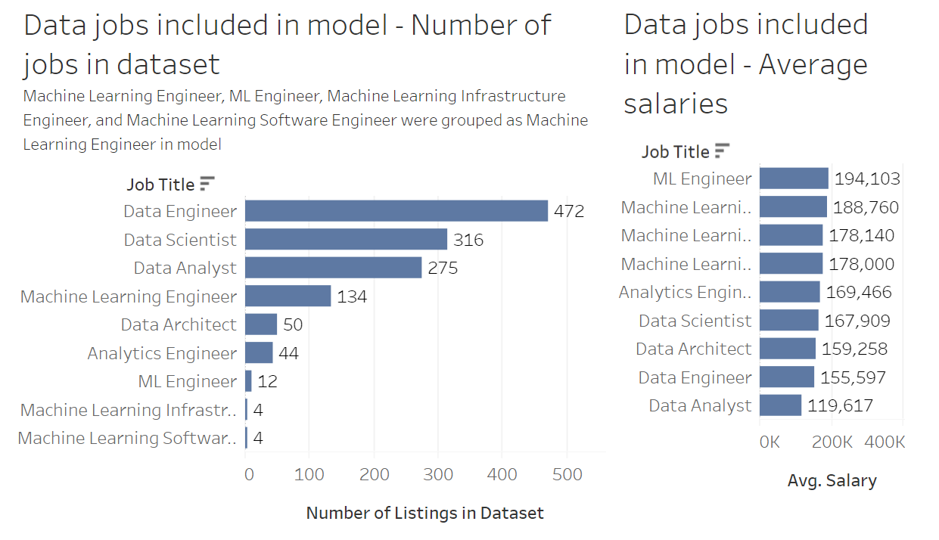
Implementing the Random Forest Model
Model accuracy
Feature importance
Average Salary per job title - model
Model accuracy - 63%
Model predicts salaraies between 101K to 200 K USD with highest precision – 73%.
June 11, 2023
Data-Related Jobs Salary Predictor app
14

Slide 15
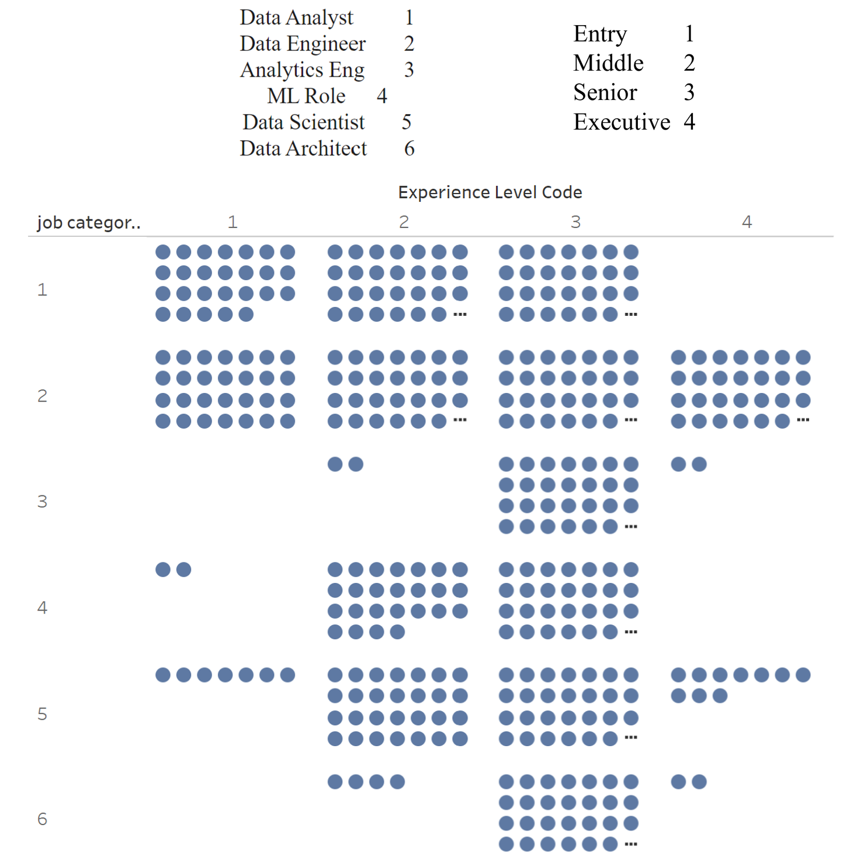
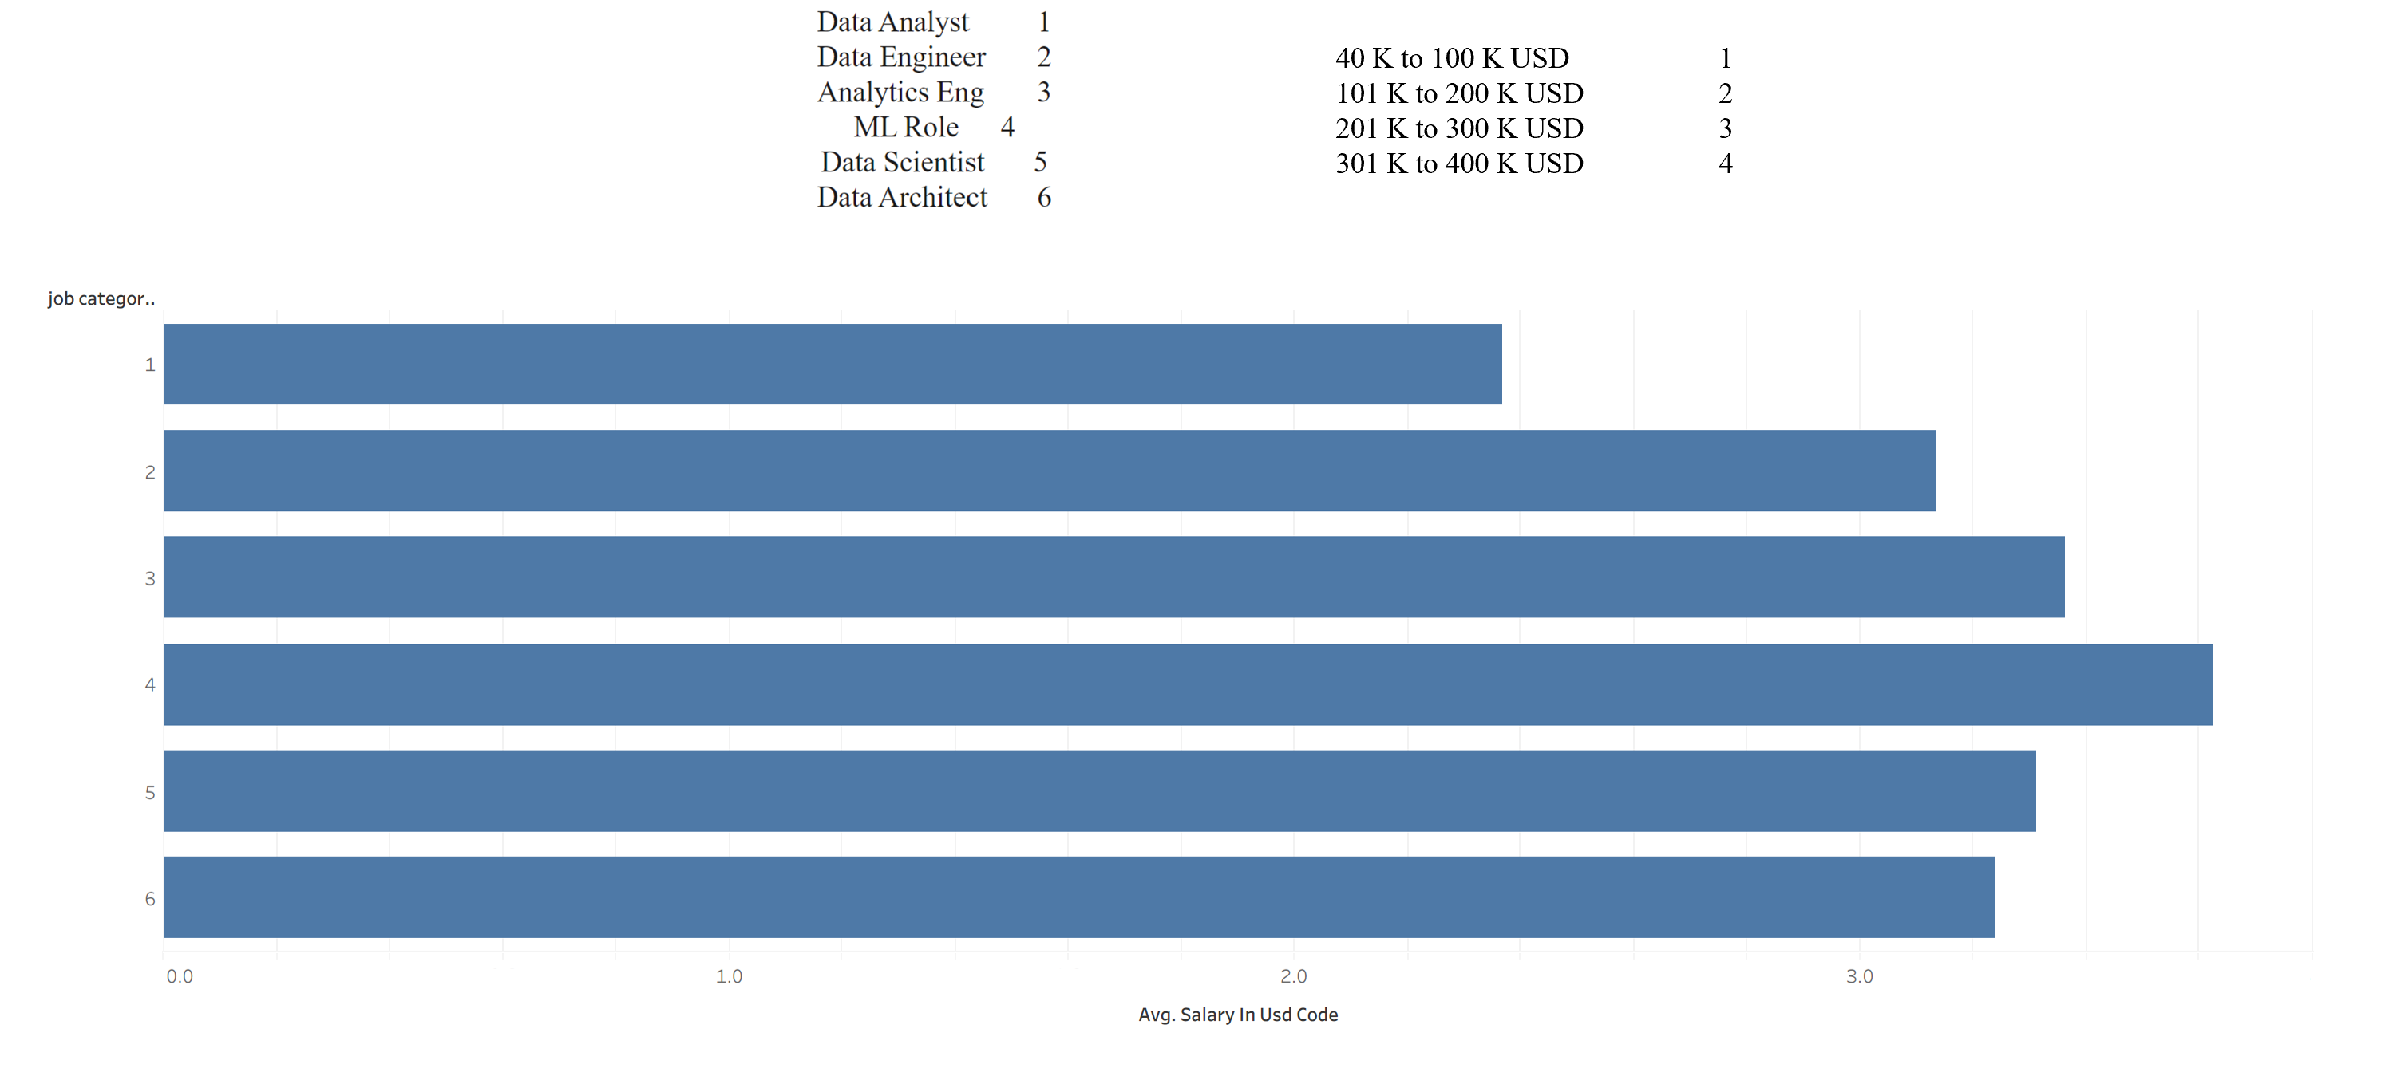
Data Analysis - Model
Average Salary per job title - model
Experience Level frequency per Job TITLE
Data engineer data spans all experience levels
Across all job titles, the majority of data in the model is in mid and senior levels of experience.
June 11, 2023
Data-Related Jobs Salary Predictor app
15

Slide 16
Website Development
Used Flask, HTML and CSS to build a user interface to get salary predictions based on user input.
Refined the coding to optimize appropriate flow and navigation among website pages (eg, included error messages for data entry validation, button to return to calculator from prediction and tableau pages)
Added pages with supportive data visualizations for users who wanted additional background on the data science employment landscape and the development of the model.
June 11, 2023
Data-Related Jobs Salary Predictor app
16

Slide 17
App Files
Python
app
HTML
index
evenmoretableau
results
tab
moretab
CSS
styles1
totalcompinfo
styles2
June 11, 2023
Data-Related Jobs Salary Predictor app
17

Slide 18
App Navigation
Salary Prediction
Landing Page (Calculator Form)
tableau 1
Total Compensation Info
tableau 2
tableau 3

Slide 19
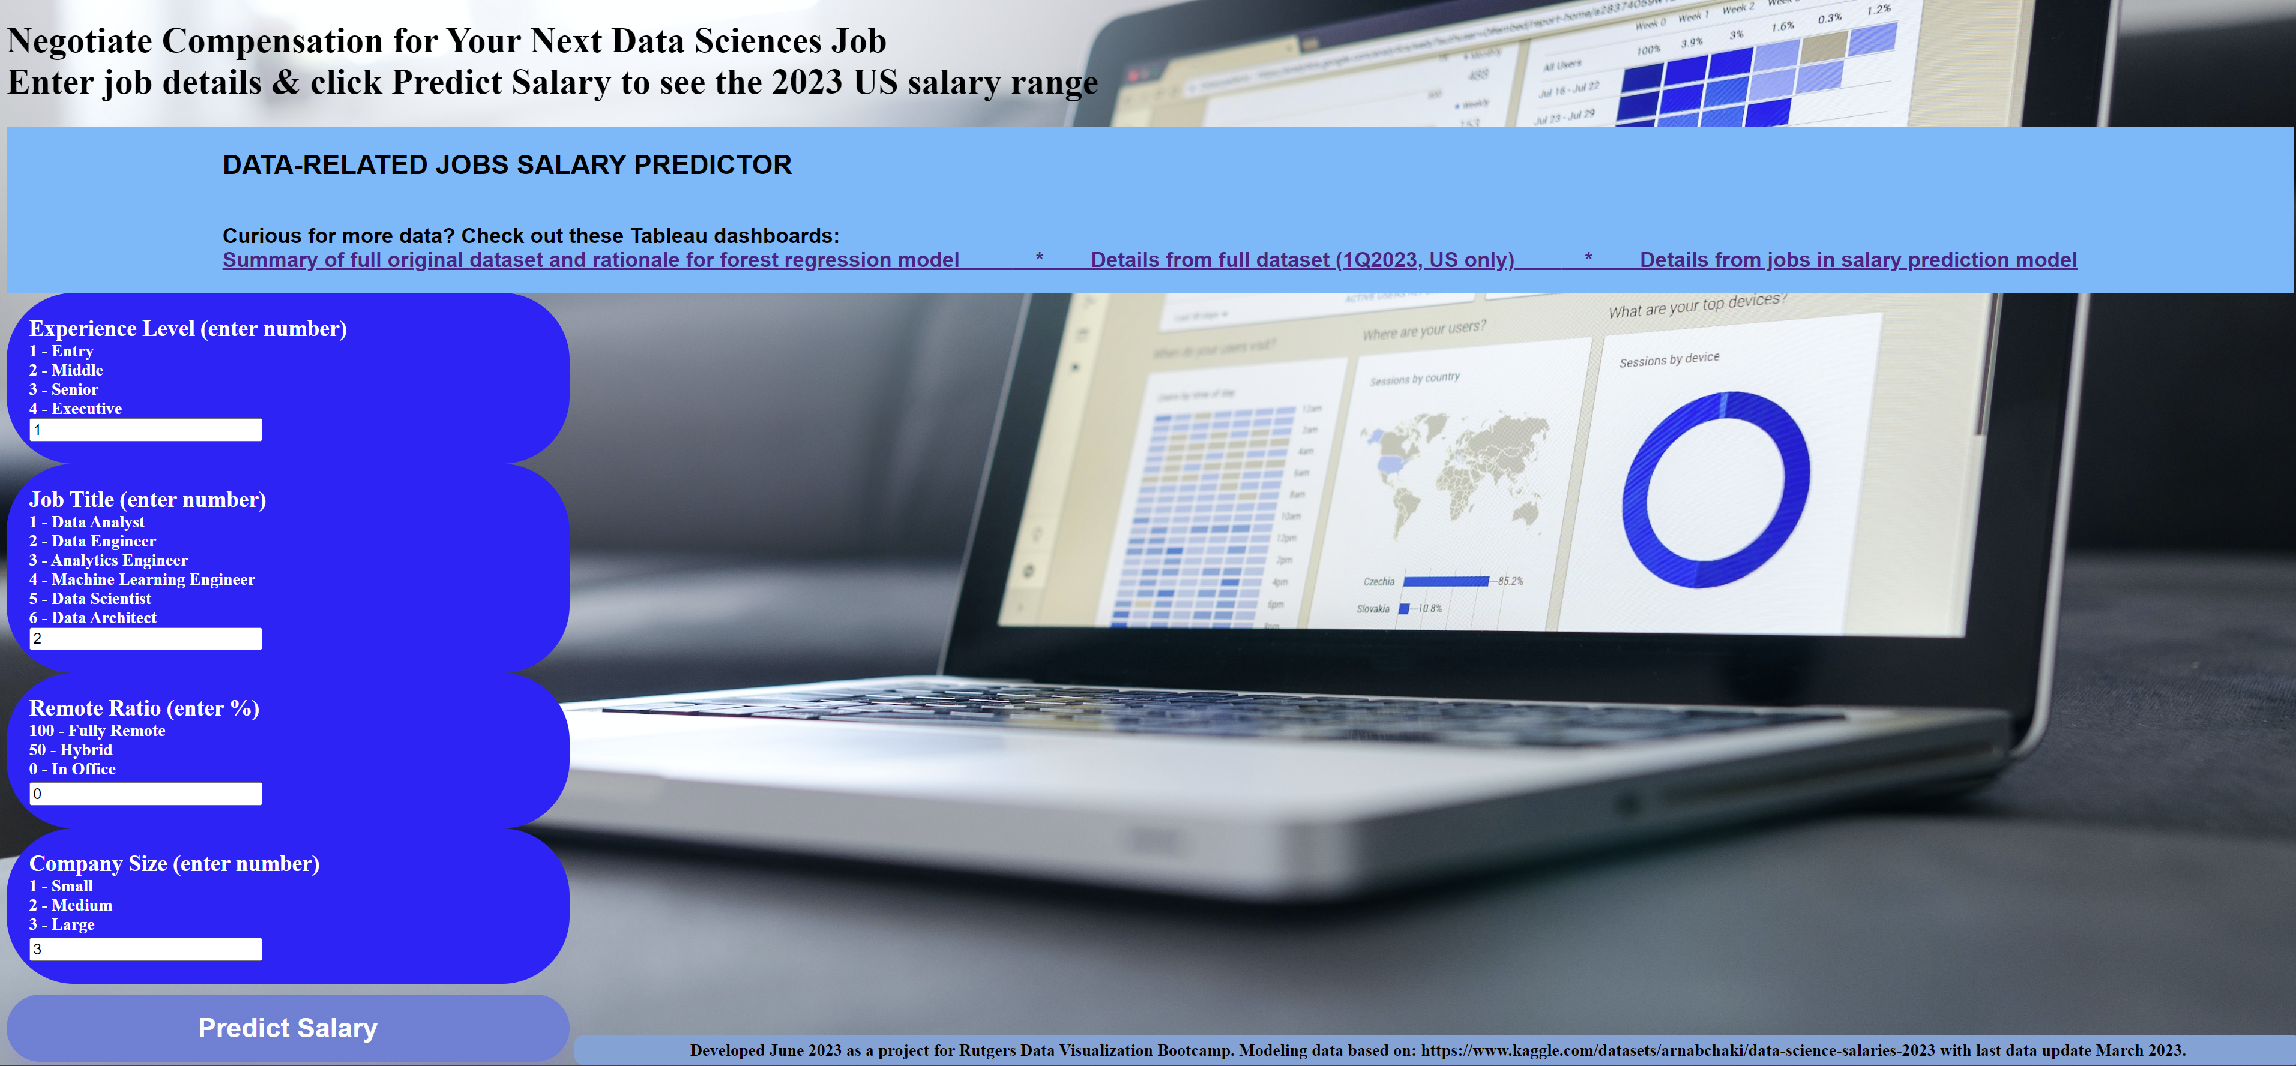
Data-Related Jobs Salary Predictor app - Landing Page

Slide 20
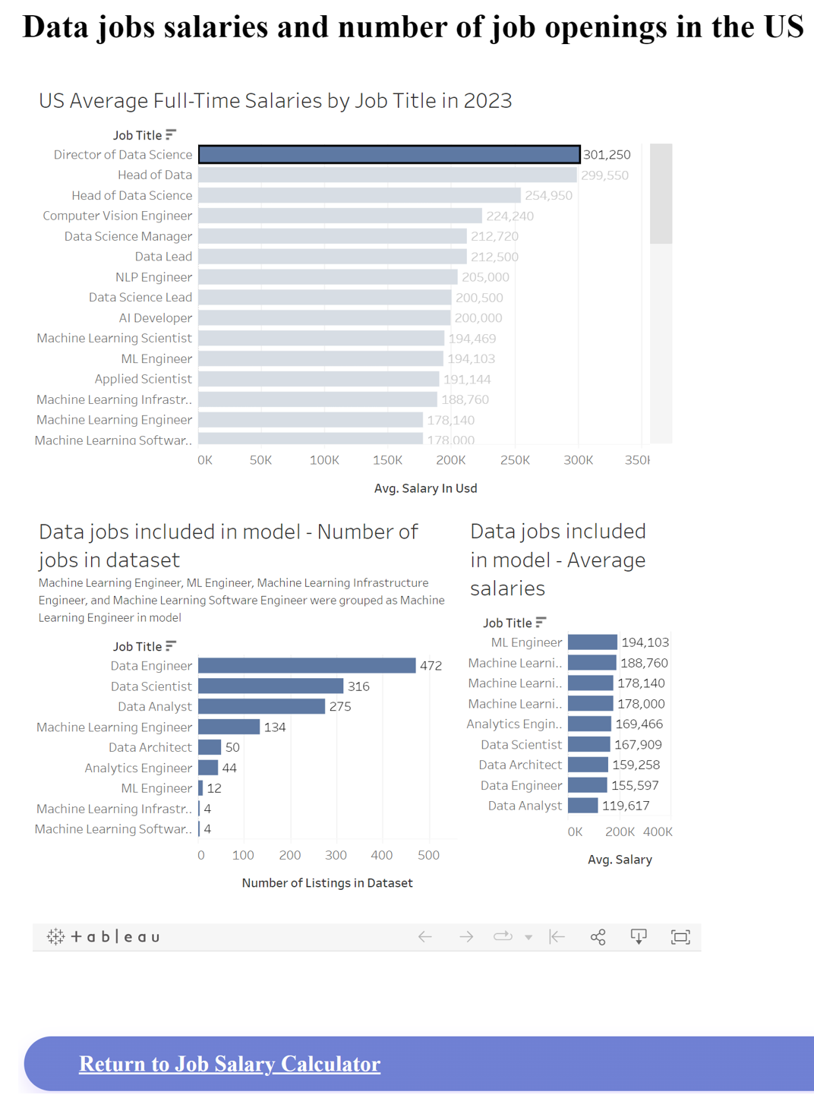
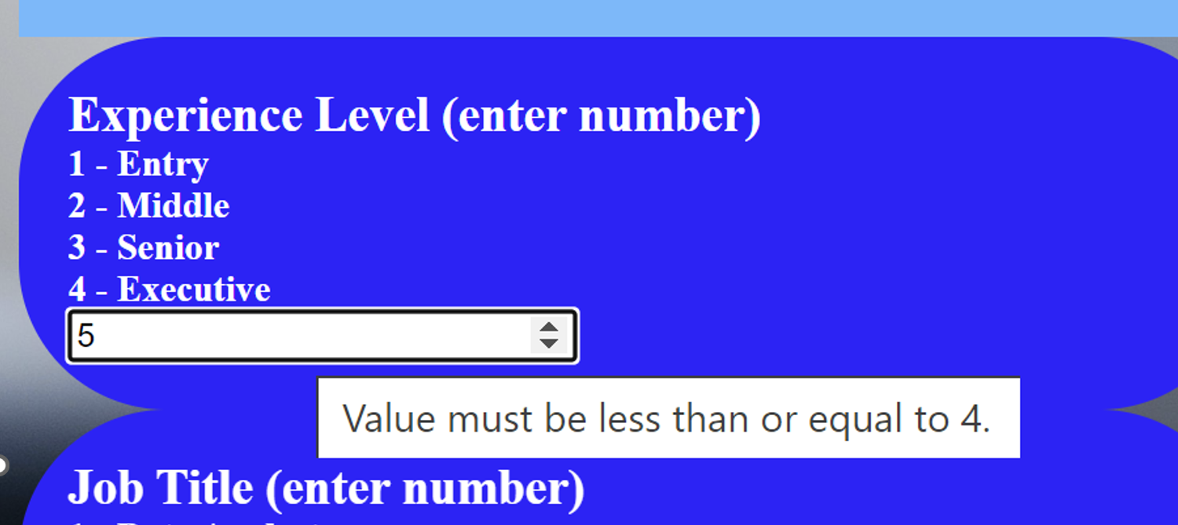
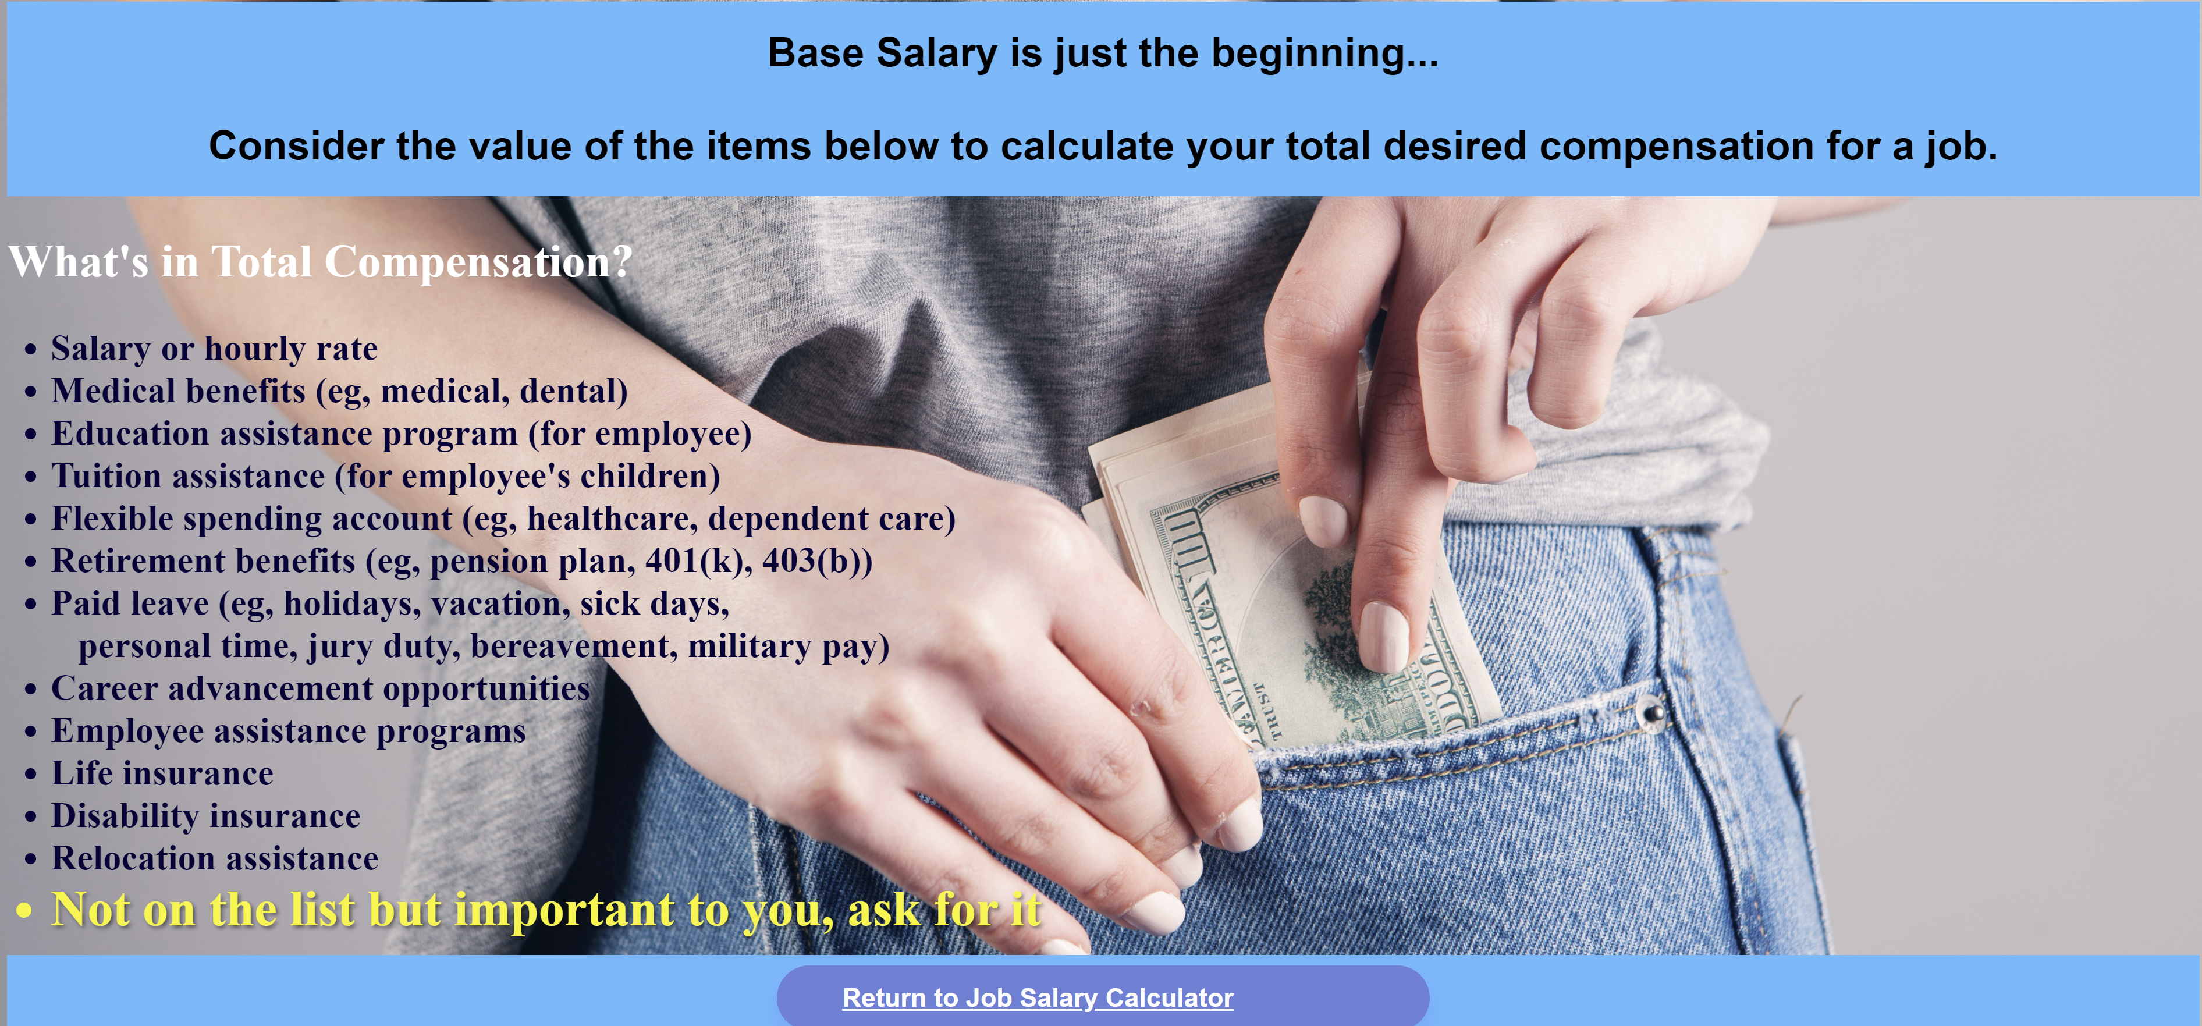
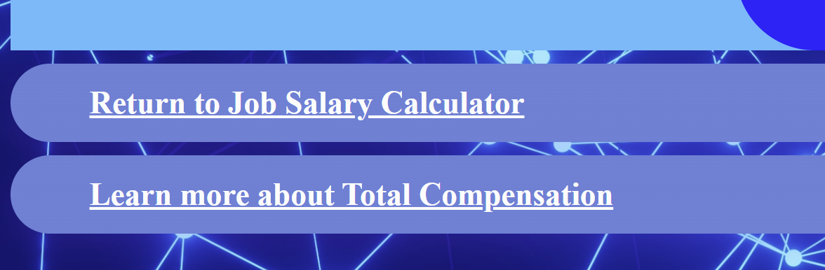
App Navigation and User Experience
Example of tableau visualization from one of the 3 pages user can navigate to for supporting data about the original dataset and the model
Error on the data entry form prompting user for appropriate data entry within prespecificed parameters
Buttons to navigate among pages
Educational page about compensation

Slide 21
Model Implementation
Live demonstration Link
June 11, 2023
Data-Related Jobs Salary Predictor app
21

Slide 22
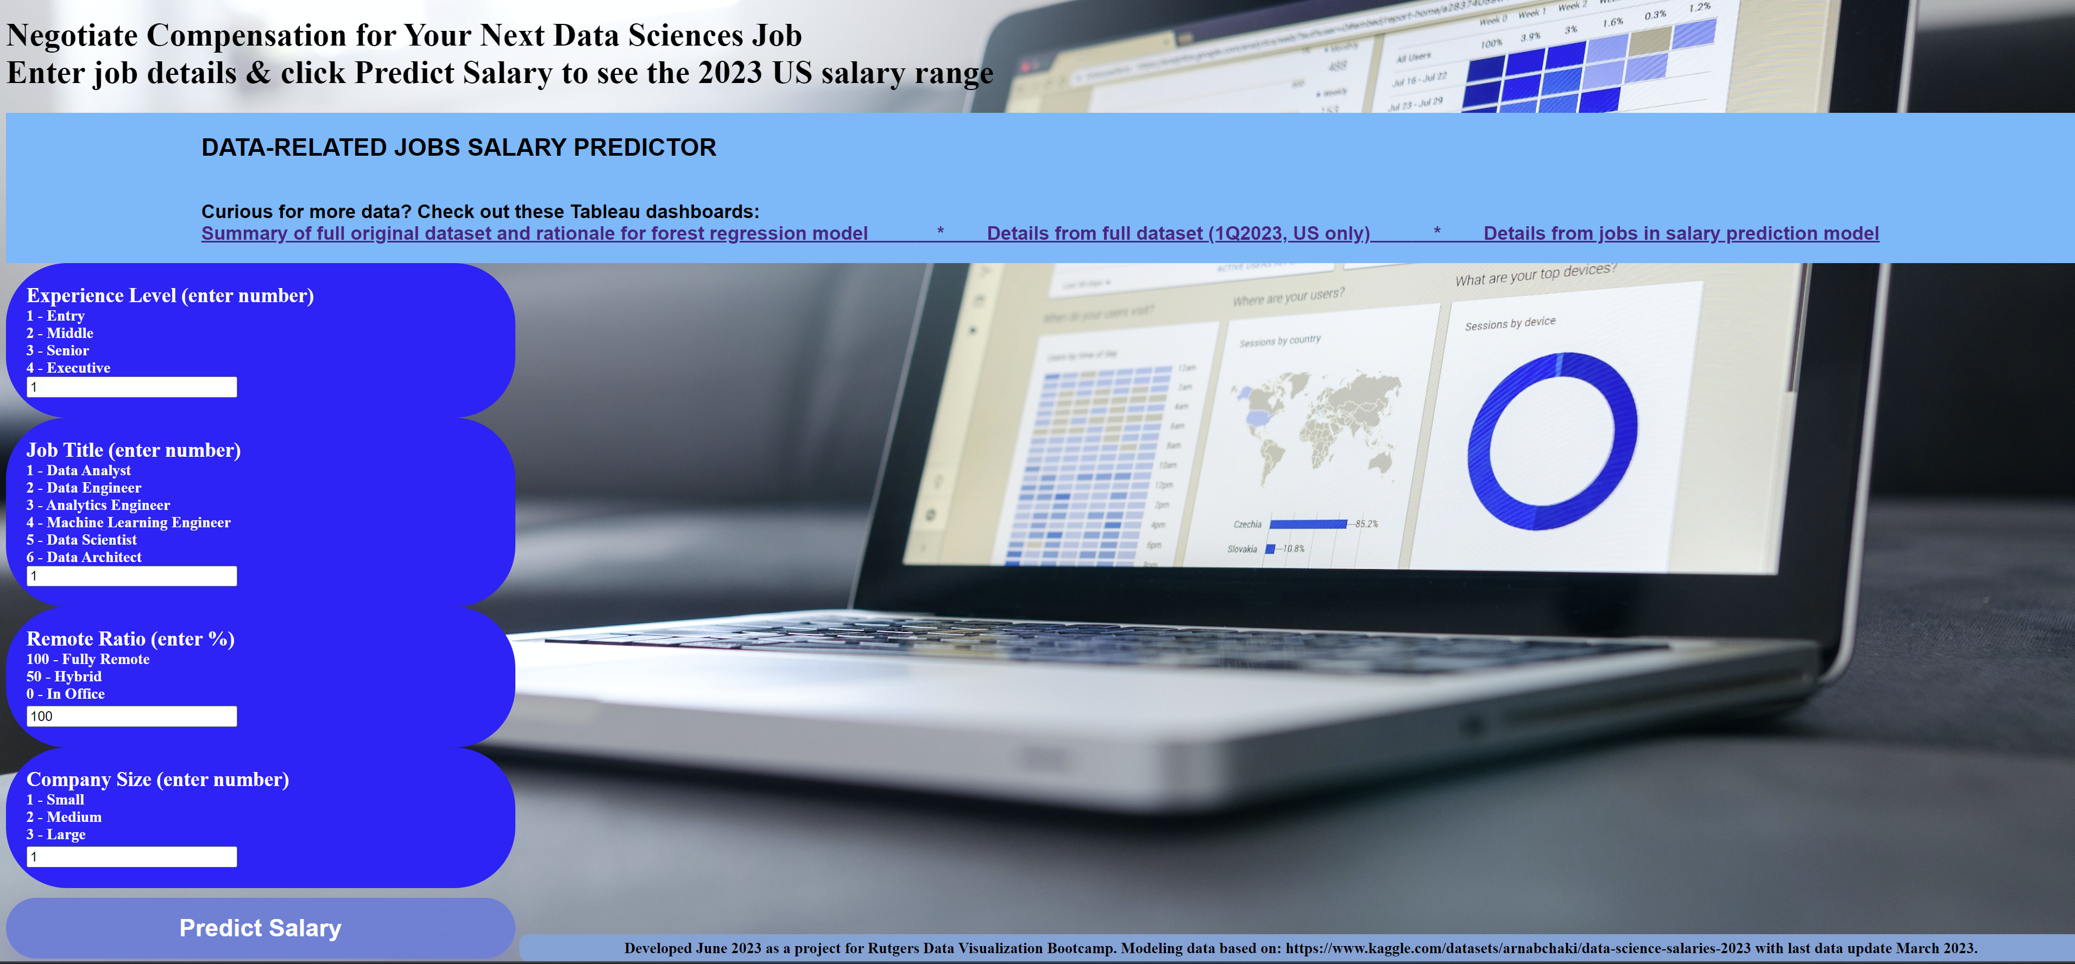
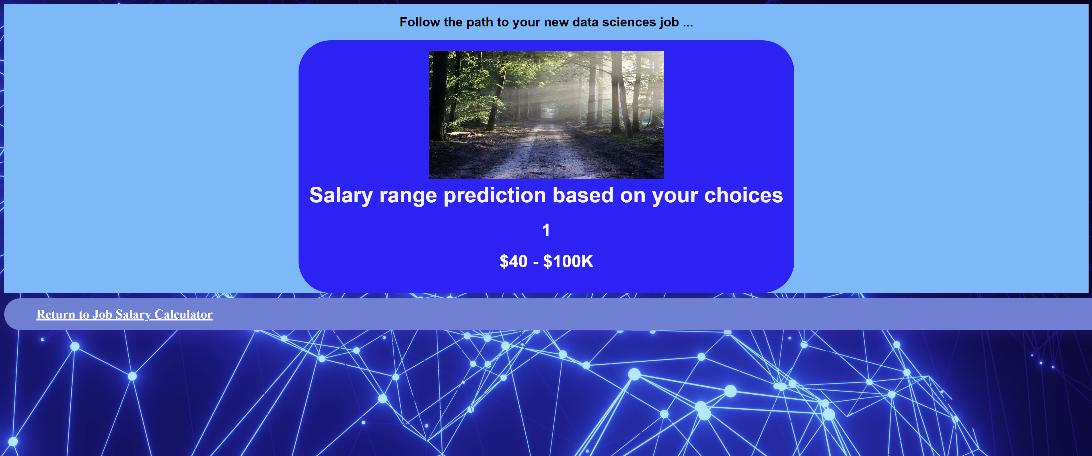
Data Entry & Results Prediction Demonstrration
Data Entry
Entry level, data analyst, 100% remote, small company
Results Prediction
Predicted salary between 40-100K USD

Slide 23
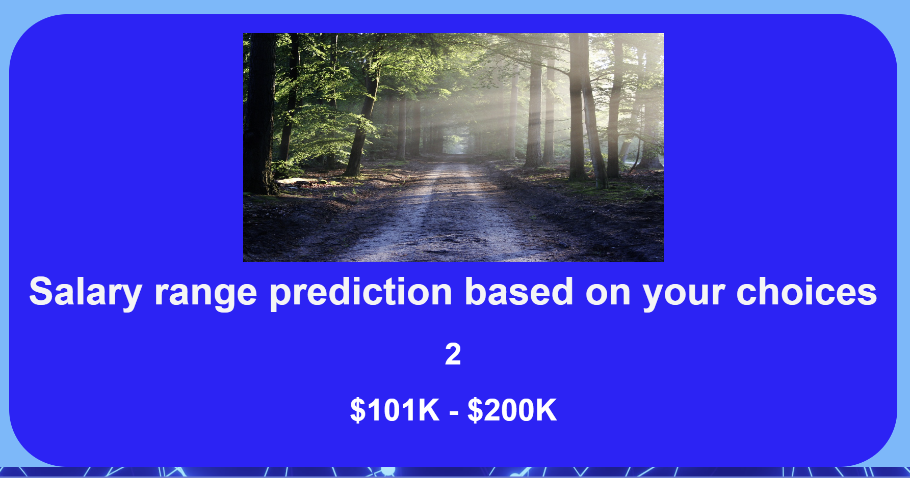
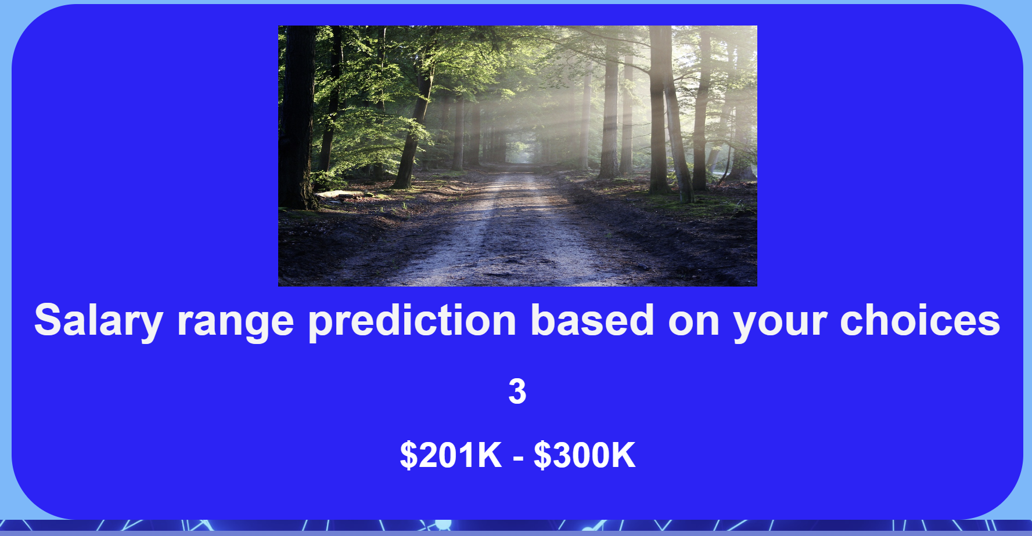
Sample Salary Predictions
Mid level, data engineer,
50% remote, mid-size company
Senior level, data scientist,
50% remote, large company

Slide 24
Summary
The model was trained and the goal of the project was met.
The app is functional for predicting salary of a job in the data sciences in the US based on four inputs.
Model can be refined in the future and updated as well with new data annually as it becomes available from aijobs.com through Kaggle.
June 11, 2023
Data-Related Jobs Salary Predictor app
24

Slide 25
Lessons Learned
Flexibility: Be flexible when refining the dataset and model. Data modeling is iterative and the model evolves as our understanding of the data deepened.
Scope Modification: We needed to reduce the scope based on time constraints. We planned to answer 3 questions with the model, but in the direction we built and trained the model, we are able to answer one. The model is built to predict salary based on inputs. Future steps are to complete additional models to predict job title or experience level based on salary.
Multiple people training the model in different ways independently was efficient. Allowed for earlier model completion and time available to focus on the app.
Good communication and collaboration during analysis portion & web development allowed for ease of integration of multiple parts of the app being built simultaneously.
Constant communication and frequent pushes to Github.
June 11, 2023
Data-Related Jobs Salary Predictor app
25

Slide 26



Ready to negotiate salary for your new data science position… this app is here to help. Know your worth * You are your best advocate. https://github.com/CMccormick0003/Data_Science_Salary_Trends.git
June 11, 2023
Data-Related Jobs Salary Predictor app
26

Slide 27

Data Sources
Original dataset: https://www.kaggle.com/datasets/arnabchaki/data-science-salaries-2023
Figures in the app:
Index.html: https://unsplash.com/photos/mcSDtbWXUZU
Results.html: https://unsplash.com/photos/xuTJZ7uD7PI and https://cdn.pixabay.com/photo/2015/06/19/21/24/avenue-815297_1280.jpg
Figures in the presentation:
Introduction slide: https://unsplash.com/photos/klMii3cR9iI
App Navigation slide: https://unsplash.com/photos/oWrRxo9UdM4
Know your worth slide: https://unsplash.com/photos/-8a5eJ1-mmQ and https://unsplash.com/photos/5ZnS3wK6sUg
Data Sources slide: https://unsplash.com/photos/64YrPKiguAE
Questions slide: https://unsplash.com/photos/IgUR1iX0mqM
June 11, 2023
Data-Related Jobs Salary Predictor app
27

Slide 28


Questions?
June 11, 2023
Data-Related Jobs Salary Predictor app
28

